Slide 1


The Evidence-Backed AI Impact Business Case For MiaRec CX Intelligence
A Conservative, Measurable Business Case For An AI-Driven Customer Experience (CX) Intelligence Solution
Prepared By: [Name / Team]
Date: [Date]

Slide 2

Executive Summary
We propose adopting MiaRec Customer Experience Intelligence to achieve critical business objectives:
Complete Visibility into Performance & Quality
Operational Efficiency & Performance Consistency
Measurable Customer Experience Improvement
Unlock actionable insights into every customer interaction, driving operational excellence and informed decision-making across 100% of customer engagements.
Improve consistency and execution by applying objective QA across 100% of calls, enabling targeted coaching, faster ramp-up, and more reliable performance across teams.
Leverage data-driven insights to enhance customer satisfaction and loyalty, leading to superior CX outcomes and a competitive advantage.

Slide 3
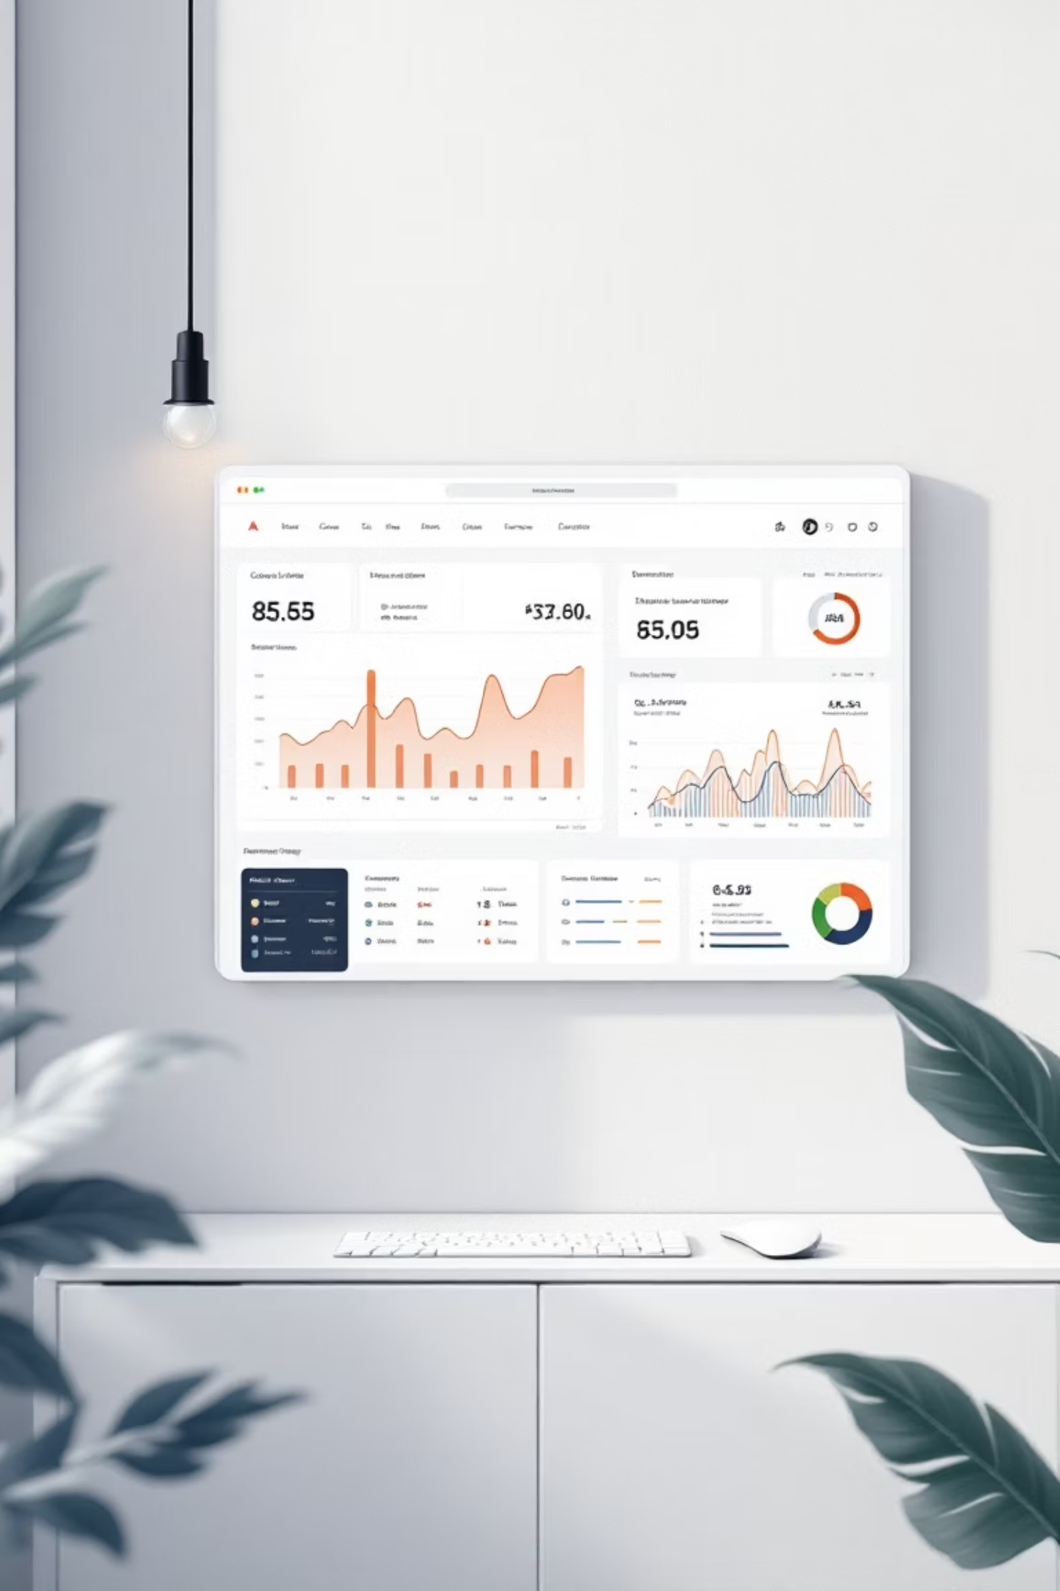
What We Are Buying & What It Delivers
1. Complete Visibility Into Performance And Quality
Unlock actionable insights into every customer interaction to drive operational excellence.
100% Conversation Visibility
Gain complete insight into every customer conversation, removing blind spots.
Identify Top & Low Performers
Confidently identify agents excelling and those needing support.
Targeted, High-Impact Coaching
Enable precise coaching based on objective quality assurance data.
Consistent Quality Standards
Apply uniform quality metrics across all teams and locations for fairness.

Slide 4

What We Are Buying & What It Delivers
2. Operational Efficiency And Performance Consistency
MiaRec's CX Intelligence directly impacts key operational metrics, fostering a more productive and stable workforce.
20–30% Faster Agent Ramp-Up
Achieved through objective QA, clear performance benchmarks, and personalized, targeted feedback for new agents.
10–20% Reduction in Agent Attrition
Driven by fair and consistent evaluations, clearer role expectations, and more effective coaching strategies that empower agents.
This fundamentally positions CX Intelligence as a performance platform, moving beyond basic reporting tools to drive tangible improvements in agent development and retention.

Slide 5

What We Are Buying & What It Delivers
3. Measurable Customer Experience Improvement
What Customers Experience
More consistent interactions across agents
Fewer friction points and moments of dissatisfaction
Faster resolution with less effort
What Leaders Gain
Clear visibility into what drives CSAT, NPS, and Effort
Early warning of CX risk before escalation or churn
Confidence CX improvements are based on real behavior — not survey noise
Measured Impact
CSAT improvement: +5–15%
20–40% reduction in low-CSAT interactions
More stable CX performance over time.

Slide 6

What Visibility Changes For Us
Making Customer Experience And Churn Risk Visible
Every customer interaction contains signals indicating customer experience risk or opportunity. Understanding these signals is crucial for proactive management.
Without Visibility, CX Problems Compound:
What Visibility Changes:
CX risk becomes visible before escalation or churn
Leaders can prioritize interactions and behaviors that matter most
Teams act on root causes, not just lagging CX scores
Unresolved issues
Inconsistent execution
Repeated friction
Inconsistent coaching

Slide 7

What If We Do Nothing
The Unseen Costs of Inaction
Without MiaRec, our current challenges persist, silently eroding customer loyalty and posing significant financial risks:
Inconsistent CX continues to drive dissatisfaction and churn risk.
Coaching remains reactive and subjective, failing to address root causes.
Survey scores fluctuate without clear explanation, hindering effective strategy.
Leaders lack confidence in where to invest time and resources for CX improvement.
This operational risk ultimately manifests as quantifiable churn exposure, impacting our bottom line:
[$X]
[X%]
Revenue Base
Current Churn Rate
Currently impacted by CX inconsistencies
Leading to significant customer attrition
[$X]
[$X]
Annual Revenue at Risk
Retained Revenue Opportunity
Estimated due to existing churn levels
From a conservative [X%] churn improvement

Slide 8
How We Will Measure Success
Our success will be measured through tangible improvements across key operational and customer experience metrics. We will prioritize the outcomes most aligned with our strategic business goals.
Derived directly from call recordings, not surveys or samples
Measured consistently across 100% of relevant interactions
Tracked against a baseline established at kickoff
Reviewed over time to confirm sustained improvement
Please note: Not all metrics need to be pursued at once — we will focus on the outcomes most aligned to our business priorities and measure progress incrementally.
Agent Performance Consistency
Reduction in Agent Ramp-Up Time
Reduction in Agent Attrition
CSAT Improvement
Fostering a more stable and experienced workforce.
Elevating overall customer satisfaction scores.
Ensuring uniform service quality across all interactions.
Accelerating new agent proficiency and productivity.
Churn Risk Improvement
Minimizing customer churn through proactive CX management.

Slide 9

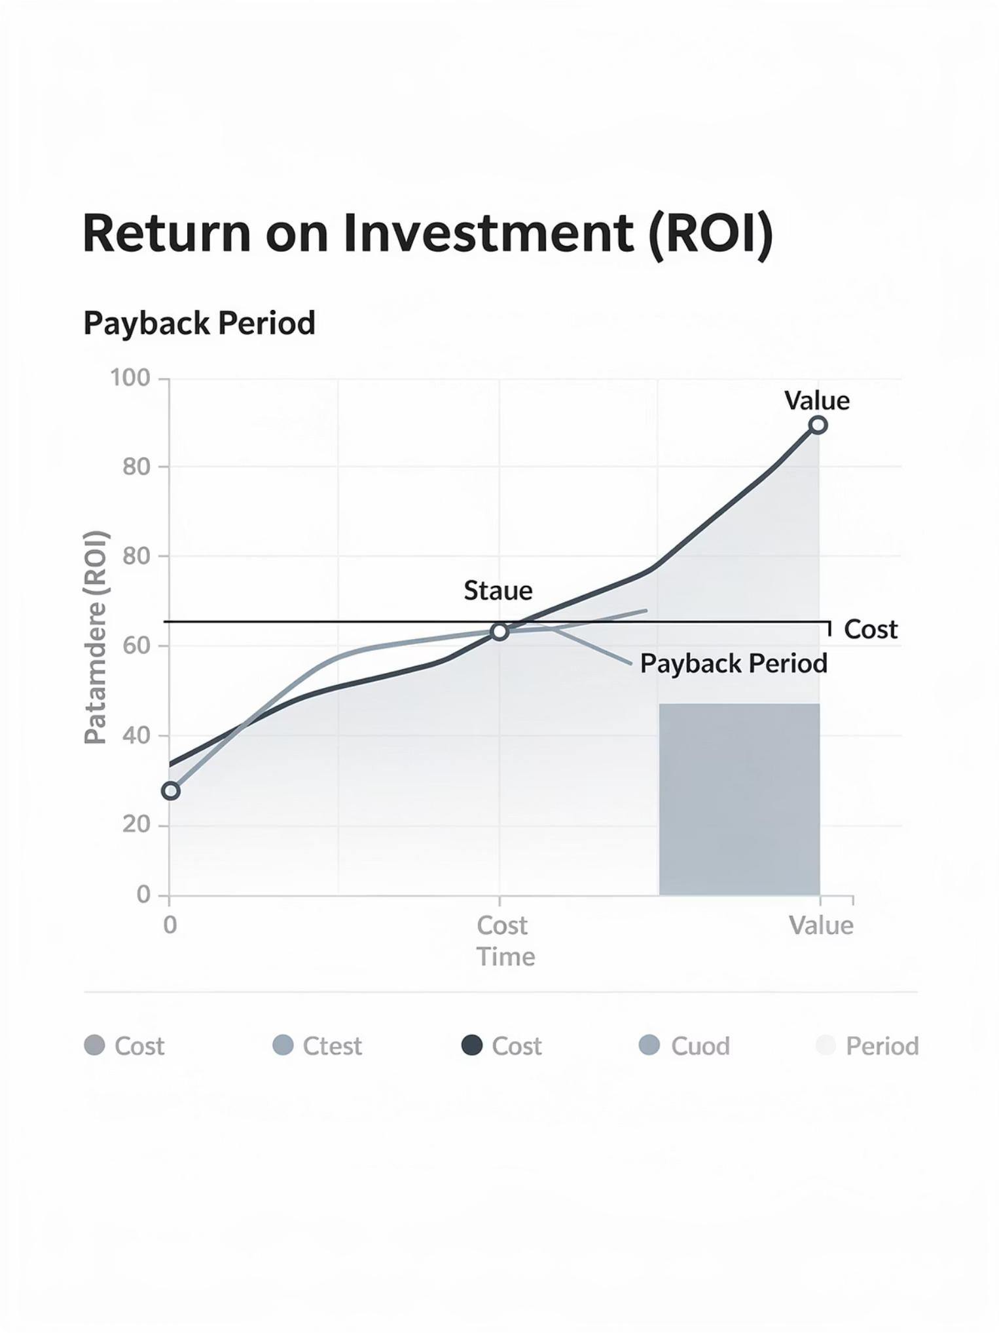
Conservative ROI Summary
Baseline Exposure
Conservative Improvement Assumption
[$X] annual exposure (churn or revenue leakage)
[X% churn reduction]
Estimated Annual Impact
Investment Assumption
[$X]
[$X] (see appendix)
Estimated Payback Period
[X months]
Confidence Factors:
Conservative assumptions
Transparent methodology
Measurable KPI reporting plan

Slide 10
Governance & Reporting
Governance And Reporting
This governance model ensures the business case remains measurable, auditable, and accountable throughout the lifecycle of the investment. This initiative will be governed with a simple, disciplined reporting model designed for executive confidence — not operational complexity.
01
02
03
04
Clear Ownership
Regular Cadence
Consistent Methodology
Early Visibility
Defined roles for reviewing results and driving actions.
Consistent executive reporting, typically on a monthly basis.
Uniform measurement applied across all metrics.
Proactive alerts if results deviate from expected targets.
What Leadership Can Expect:
Clear visibility into progress against agreed outcomes.
Early warning if results are not tracking as expected.
Confidence that reported improvements reflect real operational behavior.

Slide 11
What Is Included (Scope)
MiaRec's comprehensive solution provides all the tools necessary to transform your contact center operations, ensuring full visibility and actionable insights across the board:
Full Interaction Visibility Across Channels
Objective Agent Performance Evaluation
Gain complete insight across all customer touchpoints, including voice, chat, email, and messaging — moving beyond limited samples to a holistic view.
Implement consistent assessment of agent behaviors, quality, and execution at scale, fostering fairness and continuous improvement.
Conversation Analysis & Drivers
Customer Experience Insight
Uncover deep insights into why customers and prospects reach out, identifying key drivers, product/service issues, and common objections.
Understand the true drivers behind CSAT, NPS, Effort, and sentiment — providing visibility that extends far beyond just the scores.
Churn Risk Signals
Onboarding & Ongoing Success Support
Detect early indicators of potential customer churn or retention opportunities directly from interaction data, enabling proactive intervention.
Benefit from structured onboarding, collaborative goal setting, expert scorecard design, and continuous fine-tuning to ensure long-term impact and value.
Actionable Intelligence for Leaders
Receive prioritized insights into what’s happening, why it’s happening, and where to act — delivered via scheduled, customized reporting.

Slide 12
What Is Not Included (Scope)
While MiaRec offers extensive capabilities, it's important to clarify what falls outside its core functionality to manage expectations and avoid overlap with existing systems:
Agent Assist & Real-time Guidance
Voice Bots or Virtual Agents
MiaRec does not provide live coaching, scripted responses, or in-call recommendations.
MiaRec augments human agents; it does not replace them or interact with customers directly.
CRM or CCaaS Replacement
Ad-hoc Analysis & One-off Consulting
MiaRec integrates seamlessly with your existing platforms but does not replace them.
Designed for continuous insight, not custom, one-time analysis requests.
Generic BI or Manual Reporting
Uncontracted or Custom AI Insights
MiaRec provides tailored insights; it's not a dashboard builder or SQL-driven reporting tool.
MiaRec delivers AI insights defined in your agreement; additional custom analysis requires explicit scope alignment.

Slide 13
Project Timeline
MiaRec's streamlined deployment and onboarding process ensures rapid time-to-value, with a clear roadmap designed for efficiency and quick results over 6-8 weeks.
Phase 2: Training & Enablement (≈4 Weeks)
Phase 1: Implementation & Setup (≈2 Weeks)
Comprehensive team onboarding and user training
Coaching and usage enablement for optimal platform utilization
Establishment of regular reporting cadences for continuous insights
Seamless technical integration with existing systems
Tailored configuration aligned with specific business goals
Initial KPI and scorecard setup for performance tracking

Slide 14

Security And Data Protection
MiaRec ensures robust data security and compliance with enterprise-grade features:
Enterprise-Grade Encryption
Data is secured both in transit and at rest, utilizing industry-standard encryption protocols.
Role-Based Access Controls
Granular access permissions and comprehensive audit logging ensure data integrity and accountability.
Continuous Security Testing
Regular security assessments and proactive monitoring identify and mitigate potential vulnerabilities.
Automated Data Redaction
Optional features to automatically redact sensitive PII, PCI, and PHI from recordings.
SOC 2 Security Standards
Meticulously adherence to the stringent security standards defined by SOC 2, ensuring the highest level of protection and compliance.
For more information, please see https://www.miarec.com/security.

Slide 15
Next Steps
1. Confirm Scope & Metrics
Align on project scope, teams and define measurable success indicators with milestones.
2. Approve Investment
Secure necessary funding and formalize commitment to the project.
3. Kick Off Implementation
Initiate the technical setup and integration process.

Slide 16
Appendix: Assumptions And Methodology
This business case uses conservative assumptions and is designed to be validated through measurable KPI reporting.
Inputs Used:
[Churn rate]
[Revenue base]
[Conservative improvement assumption]
[Investment assumption]
Important Notes:
Outputs are estimates based on provided inputs
Improvement assumptions are conservative by design
Progress will be tracked through call-derived KPIs and periodic reporting
Assumptions can be adjusted as baseline measurement improves

Slide 17
Appendix: KPI Definitions (Optional)
Top Churn Drivers
Repeat-Call Rate By Root Cause
Most frequent reasons related to churn risk mentioned in calls
Frequency of repeat contacts for the same issue category
Escalation Rate
Unresolved Outcome Rate
Percentage of calls resulting in escalation indicators
Percentage of calls where resolution is not achieved based on defined criteria

