Slide 1

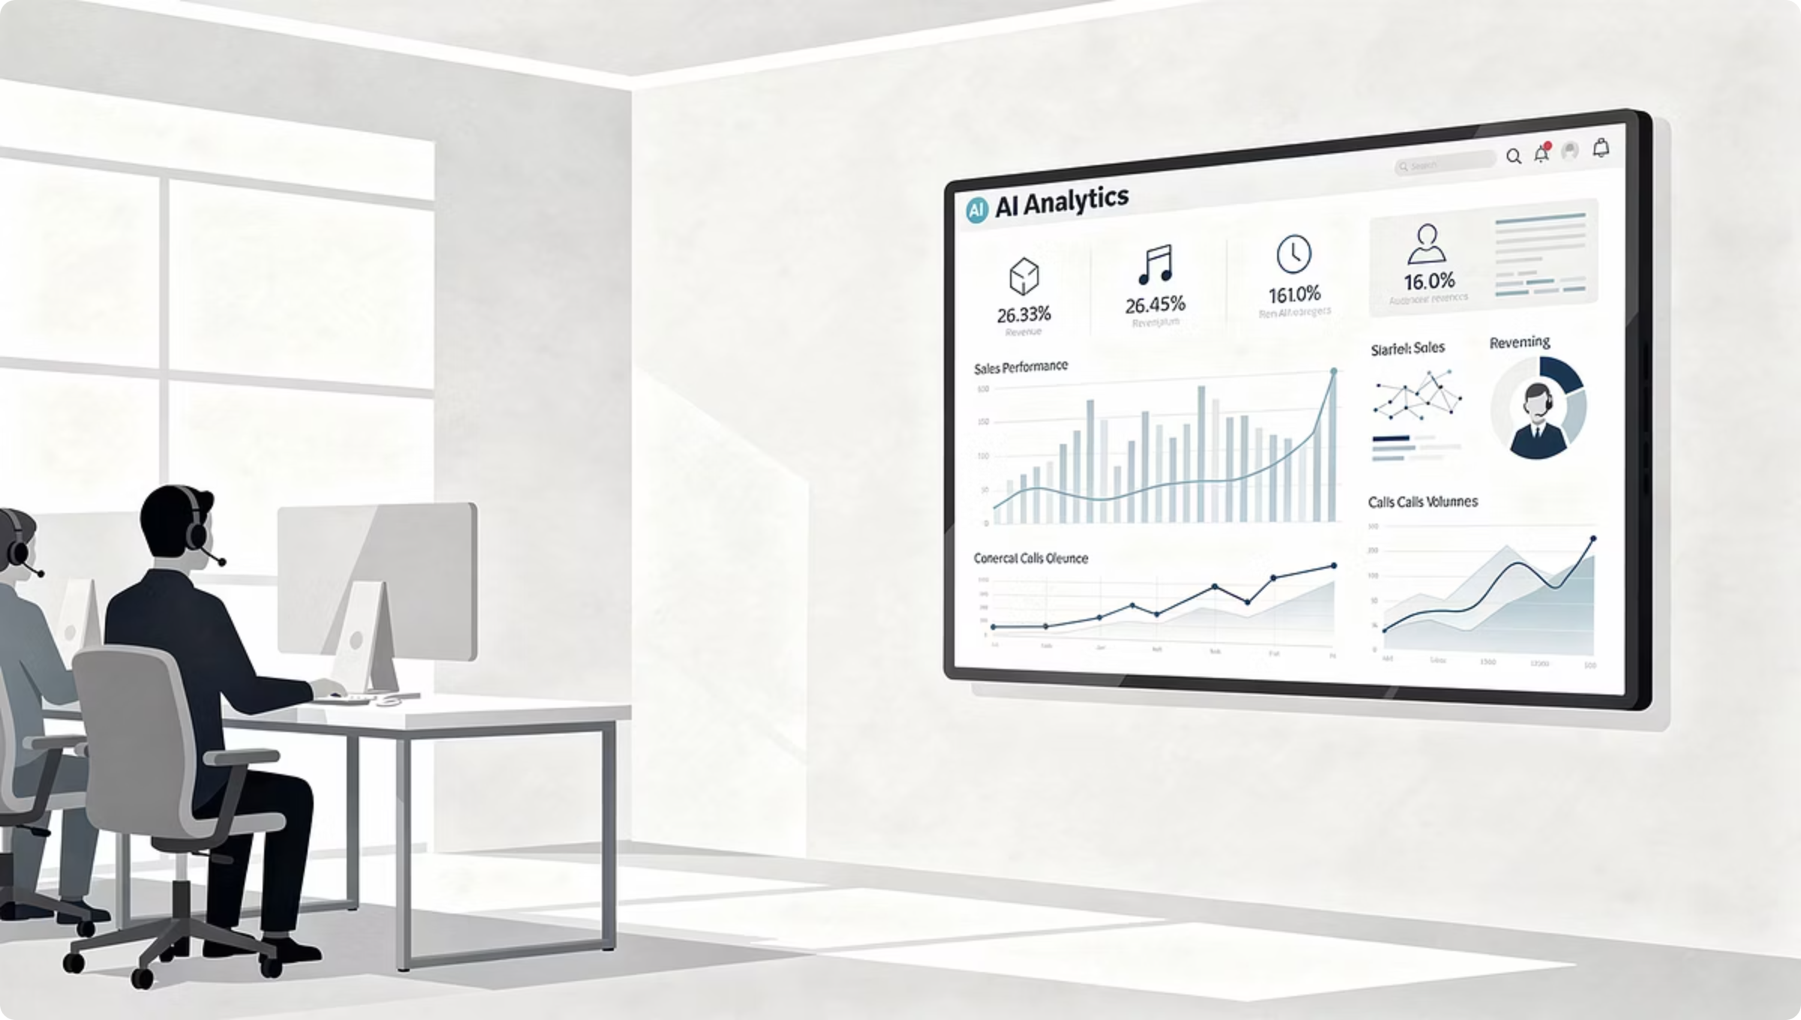
The Evidence-Backed AI Impact Business Case For MiaRec Revenue Intelligence
A Conservative, Measurable Business Case For An AI-Driven MiaRec Revenue Intelligence Solution
Prepared By: [Name / Team]
Date: [Date]

Slide 2

Executive Summary
We propose adopting MiaRec Revenue Intelligence to address critical revenue execution challenges and improve sales performance.
Complete Visibility Into Revenue Execution
Sales Execution Consistency & Performance Improvement
Measurable Revenue Impact
Gain objective visibility into 100% of sales and revenue-related conversations so leaders can clearly understand where deals are won, lost, delayed, or still recoverable — based on real customer interactions, not CRM assumptions.
Increase win rates, improve rep productivity, and shorten sales cycles by identifying missed opportunities, execution gaps, and follow-up failures early — and acting on them with evidence from real conversations.
Improve consistency in qualification, objection handling, and follow-up by applying objective analysis across all sales interactions, enabling more effective coaching and scalable best-practice execution.

Slide 3
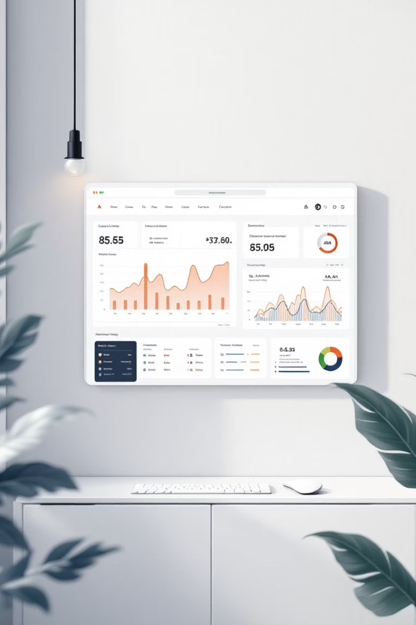
What We Are Buying & What It Delivers
1. Complete Visibility Into Revenue Execution
MiaRec Revenue Intelligence analyzes revenue-related call recordings to show where deals are won, where opportunities are missed, and what actions move deals forward.
100% Visibility Into Revenue-Impacting Calls
Surface and understand buying signals, objections, and next-step actions across all relevant conversations (without relying on CRM notes).
Expose Missed Opportunities And Root Causes
Identify patterns behind and gain clear insight into missed opportunities, lost deals, and execution gaps (weak follow-up, unaddressed objections, stalled execution).
Early Detection Of At-Risk Opportunities
Surface revenue risk by identifying at-risk deals earlier so leaders can intervene before pipeline slippage becomes a forecast surprise.
Consistent Evaluation Standards
Create consistent visibility across teams so coaching is based on evidence, not anecdote.

Slide 4

What We Are Buying & What It Delivers
2. Sales Execution Consistency And Performance
AI-powered coaching helps every rep level up by showing what top performers do differently and turning insights into action.
35% Higher Sales Rep Productivity
Automate coaching and feedback so reps spend less time reviewing calls and more time selling.
50–70% Faster Skill Development
Create faster feedback loops using real conversations so improvement compounds across the team.
Coaching becomes consistent and scalable — improving execution across the whole team, not just your top performers.

Slide 5

What We Are Buying & What It Delivers
3. Revenue Acceleration: Turn Conversations Into Closed Deals
MiaRec surfaces missed opportunities, upsell signals, and next-step actions so teams can move faster and close more deals.
38% Average Increase In Win Rates
Spot upsell, cross-sell, and follow-up opportunities in every conversation to close more deals faster.
30% Reduction In Sales Cycle Length
Eliminate delays and missed follow-ups with AI-driven insights that keep deals moving forward.
Revenue impact comes from making execution gaps and missed opportunities visible early — before deals stall or slip.

Slide 6

What Visibility Changes For Us
Making Revenue Risks And Opportunities Visible
Every sales conversation contains signals of revenue risk or opportunity.
Without Visibility, Revenue Risks Compound:
What Visibility Changes:
Revenue risk becomes visible early (= intervention is possible)
Leaders prioritize the right deals and behaviors
Teams act on execution gaps, not just pipeline metrics
Potentially missed revenue can be recovered
Missed objections go unaddressed
Deals stall without follow-up
CRM data masks execution gaps
Coaching focuses on outcomes, not causes

Slide 7

What If We Do Nothing
The Unseen Costs of Inaction
Without MiaRec, our current challenges persist, silently eroding customer loyalty and posing significant financial risks:
Missed opportunities remain invisible
Deals are lost without clear explanation
Coaching remains subjective and reactive
Leaders lack confidence in pipeline quality
This operational risk manifests as quantifiable revenue leakage:
[$X]
[X%]
Revenue Base
Current Close Rate
Currently influenced by sales and revenue-related conversations
Reflects current sales execution and follow-up consistency
[$X]
[$X]
Annual Revenue at Risk
Retained Revenue Opportunity
Currently impacted by execution gaps, missed opportunities, and follow-up breakdowns
From a conservative [X%] close rate improvement driven by better visibility, coaching, and execution consistency

Slide 8
How We Will Measure Success
Our success will be measured through tangible improvements across key revenue execution metrics.
Derived directly from call recordings
Applied consistently across 100% of relevant interactions
Tracked against a baseline established at kickoff
Reviewed over time to confirm sustained improvement
Please note: Not all metrics need to be pursued at once — we will focus on the outcomes most aligned with our business priorities and measure progress incrementally.
Sales Execution Consistency
Reduction In Stalled Or Lost Deals
Objection Handling Effectiveness
Revenue Risk
Reduction
Ensuring consistent sales execution across all reps.
Reducing deal loss caused by execution gaps.
Improving how objections are handled in sales conversations.
Identifying and reducing revenue risk earlier.
Close Rate Improvement
Increasing the percentage of opportunities that close.

Slide 9

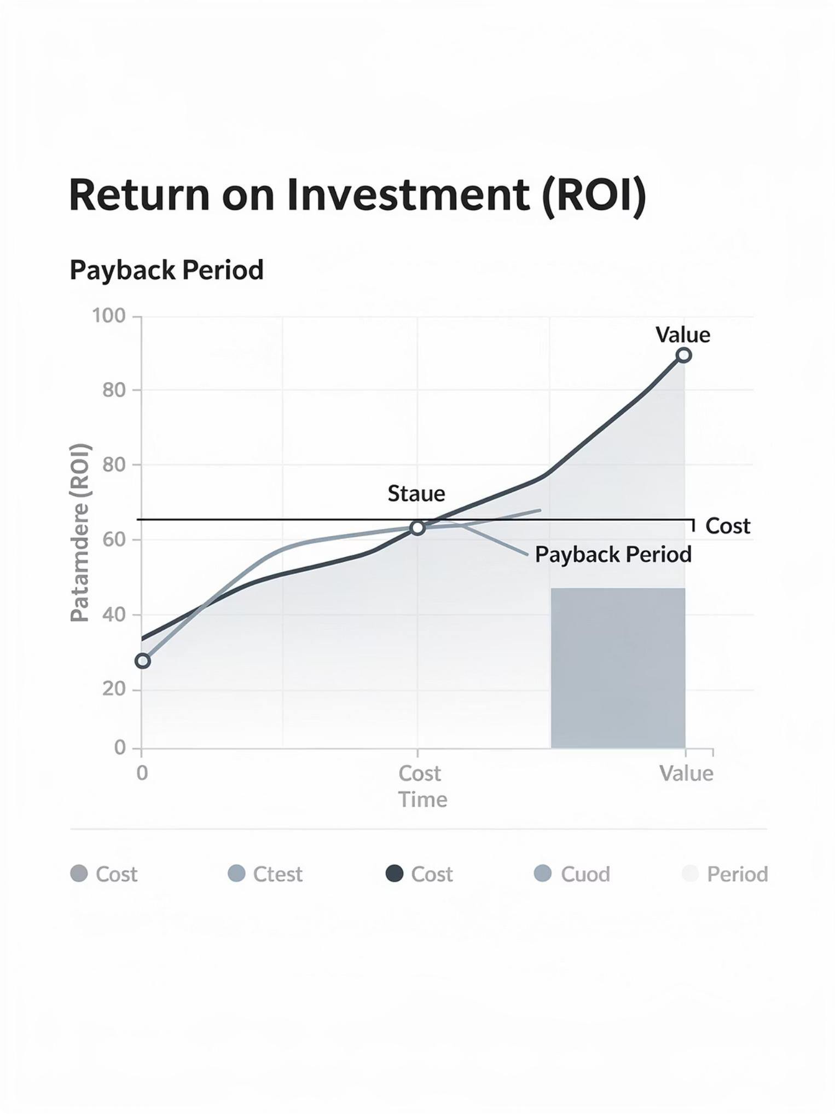
Conservative ROI Summary
Baseline Exposure
Conservative Improvement Assumption
[$X] annual revenue leakage
[X% close-rate improvement]
Estimated Annual Impact
Investment Assumption
[$X]
[$X] (see appendix)
Estimated Payback Period
[X months]
Confidence Factors:
Conservative assumptions
Transparent methodology
Measurable KPI reporting plan

Slide 10
Governance & Reporting
Governance And Reporting
This governance model ensures the business case remains measurable, auditable, and accountable throughout the lifecycle of the investment. This initiative will be governed with a simple, disciplined reporting model designed for executive confidence — not operational complexity.
01
02
03
04
Clear Ownership
Regular Cadence
Consistent Methodology
Early Visibility
Defined roles for reviewing results and driving actions.
Consistent executive reporting, typically on a monthly basis.
Uniform measurement applied across all metrics.
Proactive alerts if results deviate from expected targets.
What Leadership Can Expect:
Clear visibility into progress against agreed outcomes.
Early warning if results are not tracking as expected.
Confidence that reported improvements reflect real operational behavior.

Slide 11
What Is Included (Scope)
MiaRec's comprehensive solution provides all the tools necessary to transform your contact center operations, ensuring full visibility and actionable insights across the board:
Full Interaction Visibility Into Revenue Conversations
Root-Cause Insight Into Revenue Performance
Gain insight into 100% of sales and revenue-impacting interactions, not just samples, to see where deals are won, lost, or stalled.
Understand why deals are won or lost by surfacing buying intent, objections, missed upsell/cross-sell opportunities, and follow-up gaps in real conversations.
Actionable Execution And Coaching Insight
Revenue Opportunity And Leakage Signals
See what top performers do differently and coach consistently by turning conversation signals into clear recommendations.
Reveal missed revenue opportunities and where revenue is leaking so you can act before opportunities slip away.
Predictable Forecasting And Decision Support
Structured Onboarding & Ongoing Success Support
Improve pipeline predictability with data that ties conversational signals to revenue outcomes, enabling confident planning and prioritization.
Get guided support for configuration, KPI setup, and reporting so insights are meaningful and tied to business priorities from day one.

Slide 12
What Is Not Included (Scope)
While MiaRec offers extensive capabilities, it's important to clarify what falls outside its core functionality to manage expectations and avoid overlap with existing systems:
Agent Assist & Real-time Guidance
Voice Bots or Virtual Agents
MiaRec does not provide live coaching, scripted responses, or in-call recommendations.
MiaRec augments human agents; it does not replace them or interact with customers directly.
CRM or CCaaS Replacement
Ad-hoc Analysis & One-off Consulting
MiaRec integrates seamlessly with your existing platforms but does not replace them.
Designed for continuous insight, not custom, one-time analysis requests.
Generic BI or Manual Reporting
Uncontracted or Custom AI Insights
MiaRec provides tailored insights; it's not a dashboard builder or SQL-driven reporting tool.
MiaRec delivers AI insights defined in your agreement; additional custom analysis requires explicit scope alignment.

Slide 13
Project Timeline
MiaRec's streamlined deployment and onboarding process ensures rapid time-to-value, with a clear roadmap designed for efficiency and quick results over 6-8 weeks.
Phase 2: Training & Enablement (≈4 Weeks)
Phase 1: Implementation & Setup (≈2 Weeks)
Comprehensive team onboarding and user training
Coaching and usage enablement for optimal platform utilization
Establishment of regular reporting cadences for continuous insights
Seamless technical integration with existing systems
Tailored configuration aligned with specific business goals
Initial KPI and scorecard setup for performance tracking

Slide 14

Security And Data Protection
MiaRec ensures robust data security and compliance with enterprise-grade features:
Enterprise-Grade Encryption
Data is secured both in transit and at rest, utilizing industry-standard encryption protocols.
Role-Based Access Controls
Granular access permissions and comprehensive audit logging ensure data integrity and accountability.
Continuous Security Testing
Regular security assessments and proactive monitoring identify and mitigate potential vulnerabilities.
Automated Data Redaction
Optional features to automatically redact sensitive PII, PCI, and PHI from recordings.
SOC 2 Security Standards
Meticulous adherence to the stringent security standards defined by SOC 2, ensuring the highest level of protection and compliance.
For more information, please see https://www.miarec.com/security.

Slide 15
Next Steps
1. Confirm Scope & Metrics
Align on project scope and teams, and define measurable success indicators with milestones.
2. Approve Investment
Secure necessary funding and formalize commitment to the project.
3. Kick Off Implementation
Initiate the technical setup and integration process.

Slide 16
Appendix: Assumptions And Methodology
This business case uses conservative assumptions and is designed to be validated through measurable KPI reporting.
Inputs Used:
Current Sales Close Rate. Reflects current sales execution and conversion performance.
Revenue Base. Revenue currently influenced by sales and revenue-related conversations included in scope.
Conservative Improvement Assumption. See Below
Investment Assumption
Important Notes:
Outputs are estimates based on provided inputs.
Improvement assumptions are conservative by design. We only assume that the conservative close rate improvement is driven by better visibility into execution gaps, objection handling, and follow-up discipline.
We assume no pricing or discounting changes, no additional sales headcount, no changes to core sales process, and no increase in lead volume or demand.
Progress will be tracked through call-derived KPIs and periodic reporting.
Assumptions can be adjusted as baseline measurement improves.

Slide 17
Appendix: KPI Definitions (Optional)
Sales Execution Consistency
Close Rate Trends
Ensuring sales conversations follow proven execution standards across all reps.
Tracking changes in the percentage of opportunities that convert to closed deals.
Reduction In Stalled Or Lost Deals
Objection Handling Effectiveness
Decreasing deal loss caused by missed follow-up or execution gaps.
Improving how common objections are addressed in sales conversations.
Revenue Risk Indicators
Identifying early signals of at-risk opportunities before deals are lost.

